Slide 1

Telco Digital Performance Data Analysis
Mini Project 3
Yogita Mane

Slide 2





Data Overview
Connectivity
Revenue model
NZ Telco Company Dataset
Includes various metrics related to mobile and broadband web traffic, online conversions, online revenue, ad impressions, clicks, and media spend. The data is segregated for mobile and broadband platforms, and for SME web traffic and book-a-call activities.
Use of mobile and broadband online advertising channels to drive web traffic and increase conversions, revenue, and overall ROI
Weekly data
Weekly data appears to be running an online advertisement campaign. Weeks commencing June 27, 2022, to February 27, 2023
Identify Trends/ Patterns
Analyse data to optimize the advertising strategy and improve campaign performance.

Slide 3

Business Questions
Which media channel has highest ROI for online conversions/revenue?
Predict Online revenue given conversion rate and clicks
Identify patterns/trends in web traffic/online conversions by media channels

Slide 4





Data Pipeline
Steps involved to identify factors that influence ROI, predict future ROI values for maximum ROI
#1 Data Preparation
#3 Model Selection
#5 Model Evaluation
Optimization
#2 Feature Selection
#4 Model Training

Slide 5

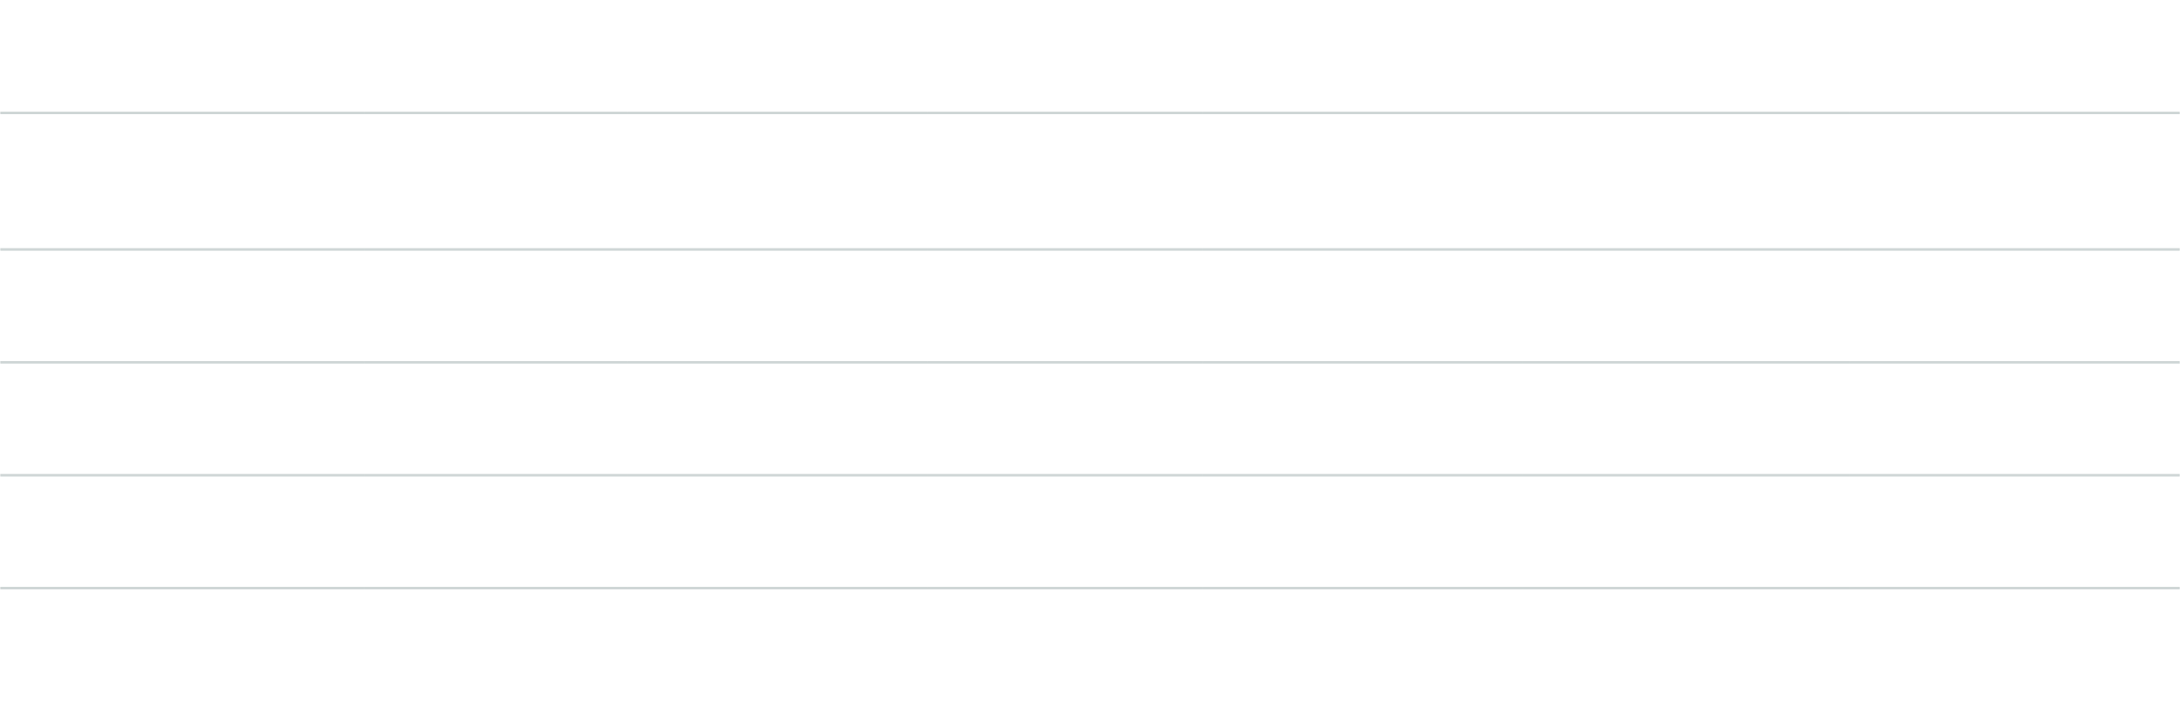
Data Analysis
Coorelations between individual channels
Mobile web traffic and online revenue have a positive relationship, as do broadband web traffic and online revenue. However, mobile media spending negatively affects both mobile web traffic and mobile online revenue; while broadband media spending weakly increases web traffic, it decreases broadband online revenue.
Investing in mobile web traffic may lead to increased revenue, while investing in mobile media spend may be ineffective. The same applies to broadband, so business should focus on optimizing the relevant platform and allocating marketing budget for maximum returns.
Mobile Web Traffic
Mobile Online Revenue
Mobile Media Spend
Broadband Web Traffic
Broadband Online Revenue
Broadband Media Spend
Mobile Web Traffic
1.000000
0.590423
-0.416716
N/A
N/A
N/A
Mobile Online Revenue
0.590423
1.000000
-0.164769
N/A
N/A
N/A
Mobile Media Spend
-0.416716
-0.164769
1.000000
N/A
N/A
N/A
Broadband Web Traffic
N/A
N/A
N/A
1.000000
0.485549
0.216686
Broadband Online Revenue
N/A
N/A
N/A
0.485549
1.000000
-0.068137
Broadband Media Spend
N/A
N/A
N/A
0.216686
-0.068137
1.000000

Slide 6
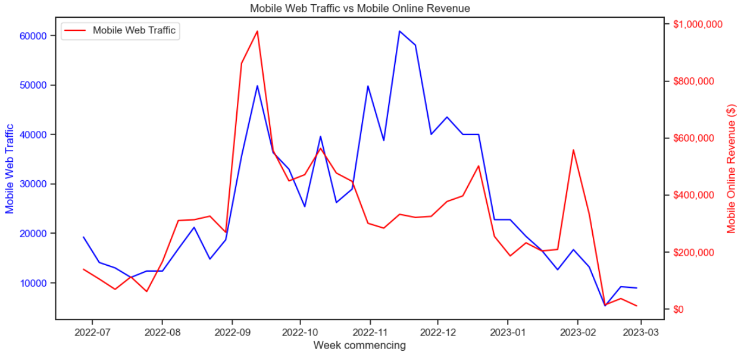
Explanatory Data Analysis
Correlation between Mobile Web Traffic and Mobile Online Revenue
Mobile Web Traffic fluctuates with a dip in mid-September 2022 (likely due to seasonal/external factors) followed by a sharp rise in early October 2022 (possibly due to increased advertising/promotional activities).
Mobile Online Revenue shows a steady upward trend with a small dip in mid-September 2022, followed by a sharp increase in early October 2022, and then gradual decline (possibly due to decreased demand/external factors).

Slide 7
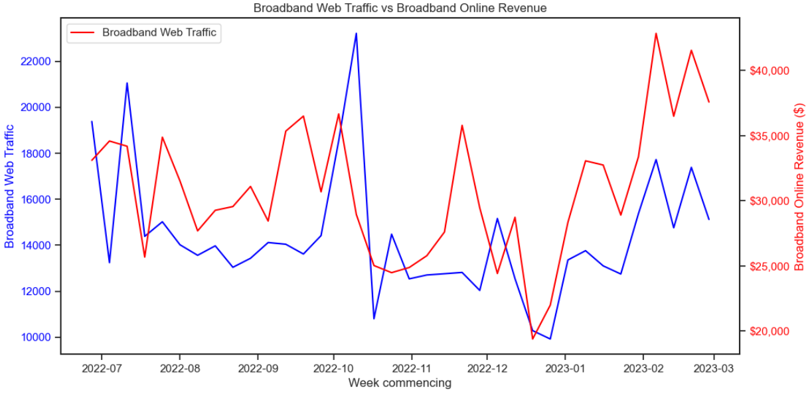
Explanatory Data Analysis
Correlation between Broadband Web Traffic and Broadband Online Revenue
The average weekly traffic and revenue for the period from June 27, 2022 to February 20, 2023 were around 14,500 and $30,000 respectively.
The highest traffic and revenue occurred in the weeks commencing October 10, 2022 and February 20, 2023 at 23,215 and $42,849 respectively. This suggests a steady increase in popularity and revenue among broadband users.

Slide 8
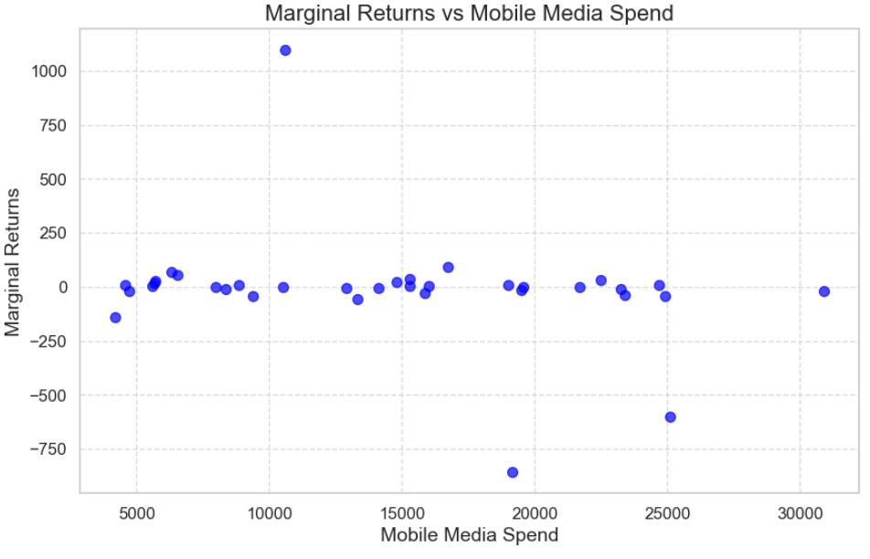
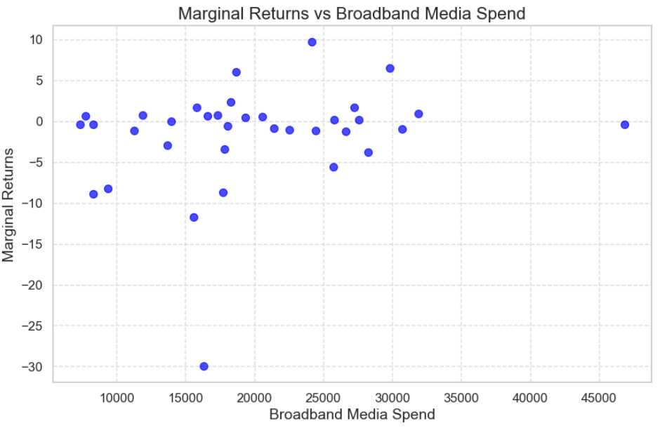
Explanatory Data Analysis
Point of Diminishing Returns for Mobile and Broadband Media Spend
Once spending over $10,585.78 on mobile media & $24,184.28 on broadband media, any further increase in mobile media spend beyond this point is likely to result in smaller and smaller returns

Slide 9
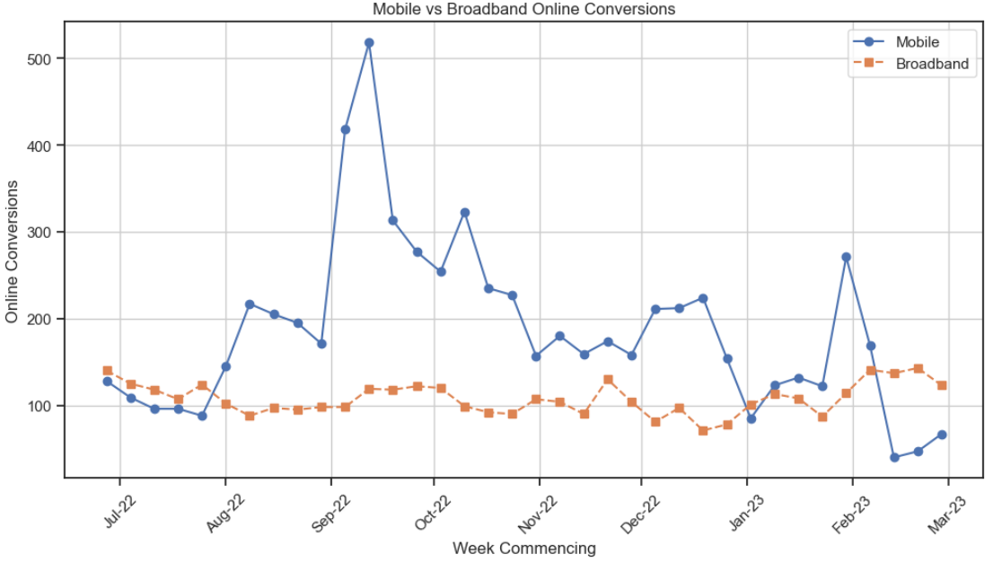
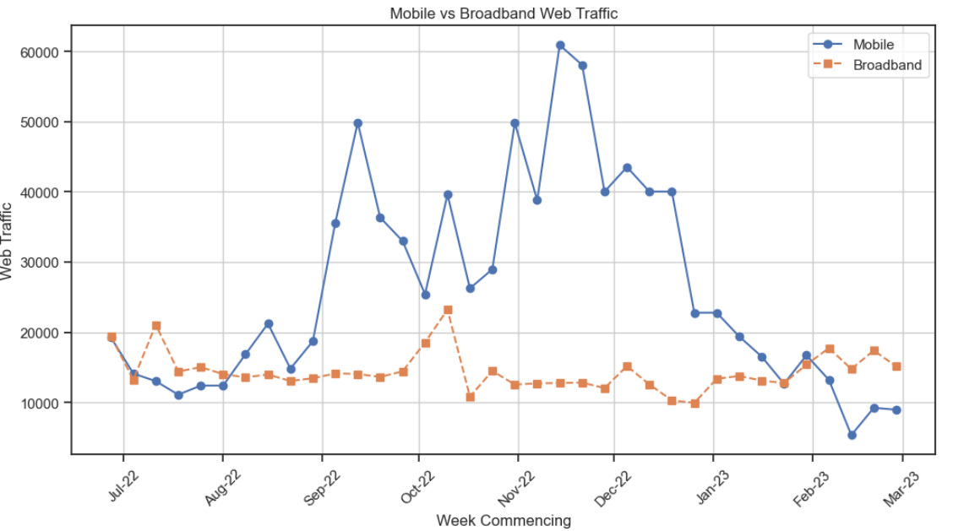
Data Visualisation
Comparison between Mobile and Broadband Online Conversion and Web Traffic
Mobile Conversions and Web Traffic are higher than Broadband Online Conversions and Web Traffic

Slide 10
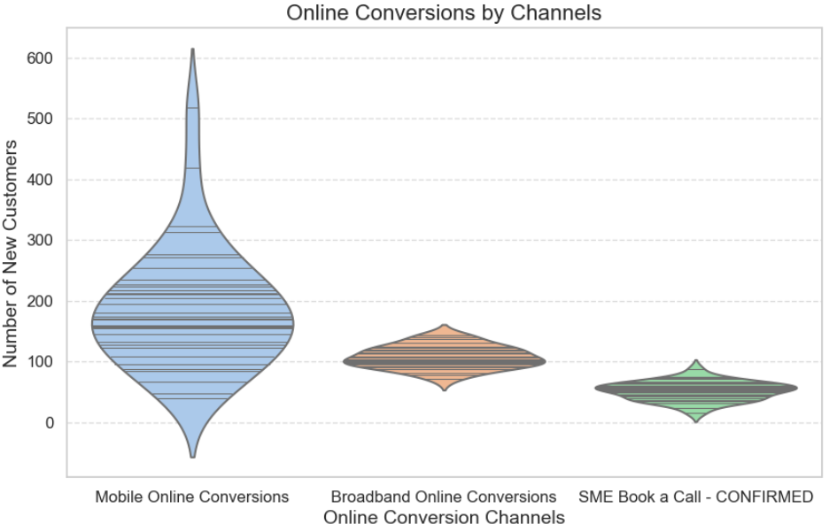
Explanatory Data Analysis
Online Conversions by Channels
Voilin plot identifies effective channels, allocate resources, optimize marketing, and improve lagging performance.
A wider violin section indicates more customers, while a narrower section suggests fewer.
Plot shows median & quartiles of distribution, aiding understanding of central tendency & spread of new customers per channel.
It would benefit marketing team to compare the violins to identify higher customer acquisition rates and channels needing improvement.
Notes:
This plot identify the most effective channels for customer acquisition, allocate resources strategically, and optimize marketing efforts to improve performance in channels that are lagging.The width of each violin represents the density of new customers at different levels for each channel. A wider section indicates a higher concentration of customers, while a narrower section suggests fewer customers.The inner stick plot displays the median and quartiles of the distribution, which can help the business understand the central tendency and spread of new customers in each channel.By comparing the shapes and widths of the violins, the business can identify which channels have higher customer acquisition rates and which channels might need improvement or further investigation.

Slide 11
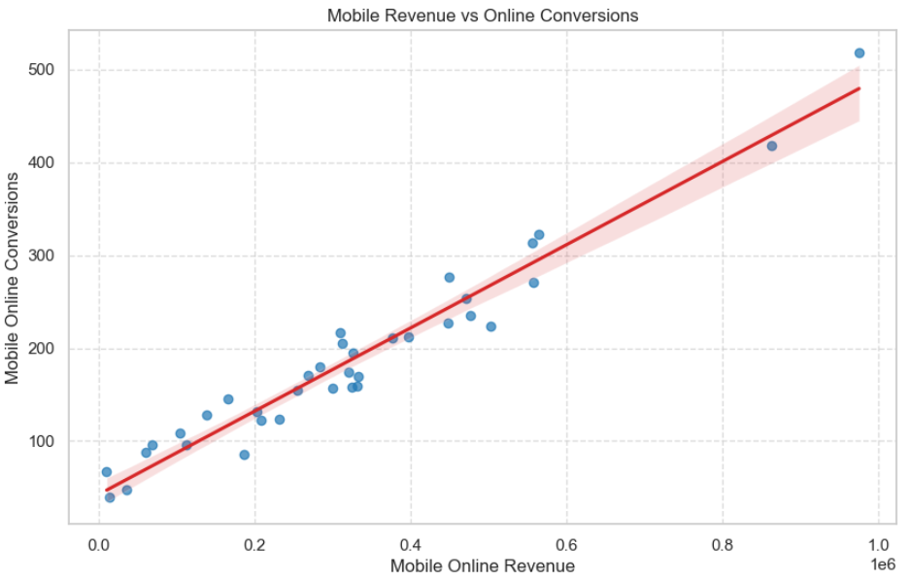
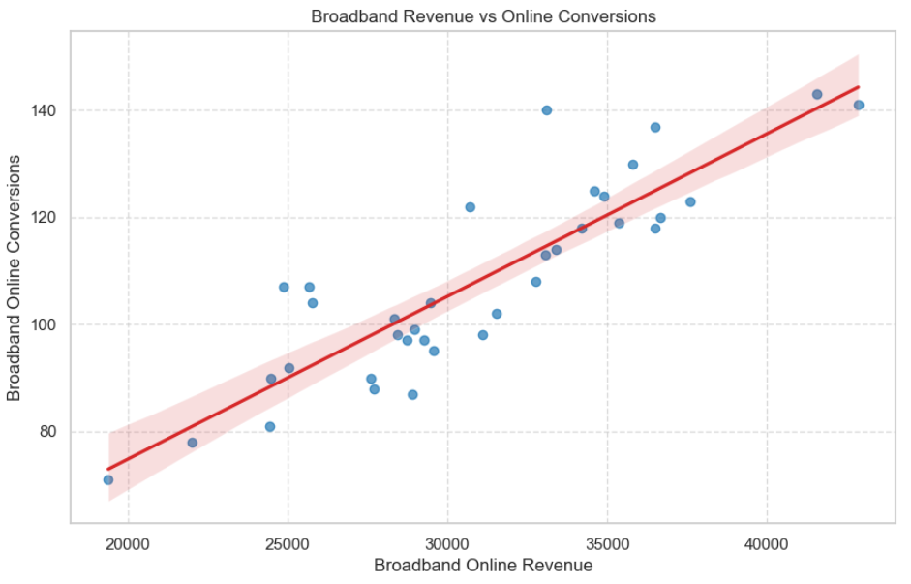
Explanatory Data Analysis
Identifying Trend and Patterns
The positive trend in both "Mobile Traffic vs Mobile Online Conversions" and "Broadband Revenue vs Online Conversions" suggest that increasing online conversions leads to a corresponding increase in revenue.
This highlights the revenue potential of both user bases (mobile and broadband) and can guide marketing teams in allocating resources.
Notes:
This information is useful for business to better understand the revenue potential of the mobile user base and prioritize mobile marketing investments. And also, the revenue potential of the broadband user base and can guide marketing team in allocating resources to target and engage users on broadband connections.

Slide 12
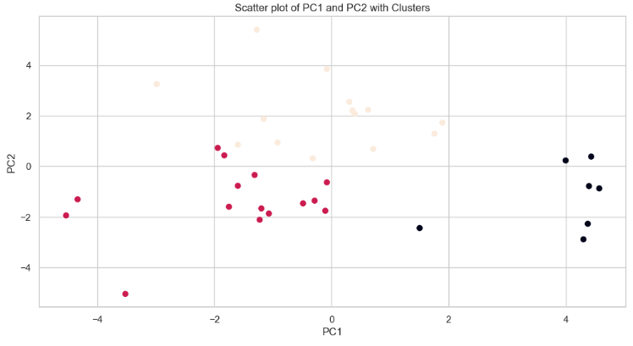
Principal component analysis (PCA)
The scatter plot suggests three clusters: Red, Yellow, and Black.
Three clusters could represent three different types of web traffic users or behavior patterns, or different subgroups.
Further analysis and data gathering is needed to determine what these groups represent.

Slide 13
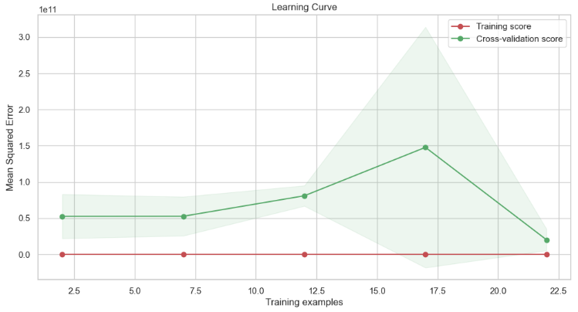
Linear Regression Model
Learning Curve - Target Variable Mobile Online Revenue
The model's training score decreases then levels off near 0 as the number of examples increases, suggesting it is fitting the data well.
As the training examples increase, the cross-validation score decreases, suggesting the model generalizes but still has some variance (with a score of ~0.2).
The learning curve indicates that the linear regression model is learning and generalizing reasonably well, but there may be room for improvement in reducing the model's variance.
The MSE on the test data is remarkably low (3.117860216311479e-11), indicating that the linear regression model is highly accurate in predicting mobile online revenue.

Slide 14
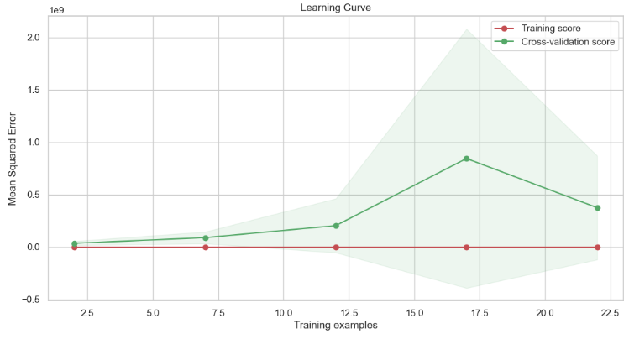
Linear Regression Model
Learning Curve - Target Variable Broadband Online Revenue
The learning curve for the linear regression model suggests it is overfitting the training data and not generalizing as indicated by the decreasing training score and increasing cross-validation score. This shows the model is not capturing the underlying patterns in the data.
The MSE on the test data is remarkably low (1.647456405253121e-14), indicating that the linear regression model is able to accurately predict the Broadband Online Revenue with very little error.
Therefore, the model is fitting the training data well, but it is not able to generalize well to new data.

Slide 15
Decision Trees Model
Mobile Online Revenue Decision Tree Score: 0.23553027146665273 Broadband Online Revenue Decision Tree Score: 0.5994158094341382 Mobile online revenue model has a score of 0.2355, lower than the 0.5994 of broadband online revenue model, indicating better performance.
Mobile Online Revenue MSE: 21886238380.5 Broadband Online Revenue MSE: 7012618.0 The MSE for the mobile online revenue model is 21886238380.5, which is quite high, whereas the broadband online revenue model has a much lower MSE of 7012618.0, indicating better performance.
It suggests Decision Tree model is performing poorly, with high errors in predictions, making it hard for businesses to make reliable decisions from its outputs.

Slide 16
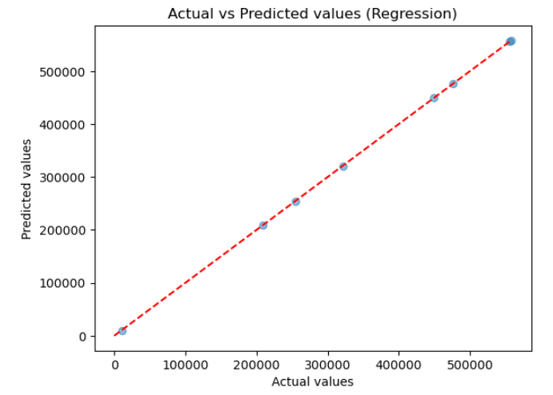
Regression Analysis
The scatter plot shows a slope of 1, indicating that the model has accurately predicted the target variable and is a good fit. Predictions can be relied upon.
MSE: 8.21e-18, R-squared: 1.0
The MSE of 8.21836364051445e-18 & an R-squared value of 1.0 indicate the model's predicted values are almost exactly the same as the actual values, with no error or deviation.
A low MSE and high R-squared value in a regression model indicate accuracy & reliable predictions.

Slide 17
Data Analytics
Return on Investments
Predicted Online Revenue
Channels
Mobile ROI: 29.55134352389633 Broadband ROI: 0.9242191394343714 SME ROI: 24.06665688719855
For every $1 spent on Mobile advertising, a return of $29.55 is seen (highest ROI). Broadband channel has an ROI of 0.92, low performance, while SME channel returns 24.07 (high ROI) which suggests that efforts are paying off.
Expected revenue for each channel
For next 5 weeks, Mobile Expected Online Revenue is $17,786,496, $11,420,475, $6,594,816, $10,786,272 and $5,360,784. Broadband Expected Online Revenue is $4,634,840, $4,323,250, $4,034,066, $2,748,295 and $4,324,996 SME Expected Online Revenue is $29,500, $30,500, $33,000, $21,500, and $44000

Slide 18
ROAS (Return On Advertising Spend)
September 5, 2022 (23.25 ROAS) and September 12, 2022 (19.27 ROAS) were the highest while February 27, 2023 (0.84 ROAS) was the lowest.
High ROAS increases efficiency of advertising spend and revenue ROI.
Correlation Coefficient
A 0.2873901395791299 correlation coefficient indicates a positive, but weak, correlation between media spend and online conversions.
Differences between Channels
The t-value of 8.0719 and p-value of 1.3463e-11 show a highly significant difference in means between Mobile and Broadband Online Revenue.
It identifies which Mobile channels generate more revenue, helps understand customer behavior & preferences, and identifies growth & expansion opportunities based on performance.
Point of Diminishing Returns
Mobile Web Traffic: 13,013
Broadband Web Traffic: 21,054
SME Book a Call - START: 949
Key Findings

Slide 19
Summary and Action Plan
Increase mobile media spend to boost mobile online revenue: Data shows positive correlation.
Improve UX (User Experience), website loading speed, and optimize website for search engines to increase broadband web traffic.
Improve website UX, optimize landing pages, and provide targeted, personalized content to increase online conversions.
External factors like seasonality, promotions, and market trends may explain the unusual spikes and drops in data. The business should identify and adjust their strategies accordingly.
The SME segment is a key target for the business, with consistent traffic and ad-impressions, but there is potential to improve online conversions and optimize media spend.
Online revenue varies significantly week-to-week, but there is an overall upward trend, suggesting digital marketing efforts are successful.
Regularly analyze data to identify trends and patterns; use tools/techniques to gain website performance insights and make informed decisions to improve performance.
Monitor key metrics, adjust strategies, & maximize ROI.

Slide 20
Thank you

